Slide 1

Windowing and Clipping
Chapter 4
14 Marks

Slide 2
Introduction
The process of selecting and viewing picture with different views is called windowing
A process which divides each element of picture into its visible and invisible portions, allowing the invisible portion to be discarded is called clipping.
Window defines what is to be viewed.
Clipping means what to remove .
Viewport defines where it is to be displayed on display device.

Slide 3
Windows and Viewports
Window
Interface Window
Viewport
Information outside the viewport is clipped away

Slide 4
Terminology
World Coordinate System (Object Space) - Representation of a set of objects, all measured in the same physical units.
Window - The rectangle defining the part of the world we wish to display.
Screen Coordinate System (Image Space) - The space within the image is displayed
Interface Window - The visual representation of the screen coordinate system for “window” displays (coordinate system moves with interface window).

Slide 5
Cont….
Viewport - The rectangle on the raster graphics screen (or interface window for “window” displays) defining where the image will appear. (Default is usually entire screen or interface window.)
Viewing Transformation - The process of going from a window in world coordinates to a viewport in screen coordinates.

Slide 6
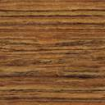
Viewing Transformation
Clip to size
of Window
Translate to
origin
Choose Window in
World Coordinates
Scale to size of Viewport
Translate to proper position on screen
(Interface Window)

Slide 7
Normalized Coordinates
Different display devices have different screen sizes and resolutions, which is measured in pixels.
Picture on a screen with high resolution appears small in size, where as same picture on screen with less resolution appears big in size.
To avoid this we make our program device independent.
So picture coordinates have to be represented in some units other than pixels.

Slide 8
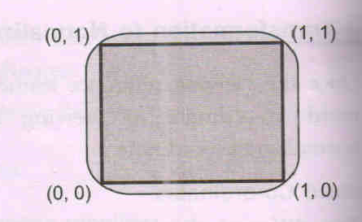
Cont…
Device independent units are called as Normalized device coordinates.
In this screen measures 1 unit wide and 1 unit length.

Slide 9
Transformation to normalized coordinates
Interpreter is used to convert normalized co-ordinates into device co-ordinates. A simple linear formula is used for this.
x = xn * Xw y = yn * Yw
Where : x= actual device x co-or
y= actual device y co-or
xn = Normalized x co-or
yn = Normalized y co-or
Xw =Width of actual screen in Pixels
Yw = Height of actual screen in Pixels

Slide 10
Viewing Transformation
An image is defined in a world coordinate system, WCS i.e. Using Cartesian coordinate system.
World Coordinate system: application-specific
Ex: drawing dimensions may be in meters, km, feet.
When picture is represented on display device,it is measured in physical device coordinate system(PDCS) corresponding to the display device.

Slide 11
Cont…
Viewing Transformation: Mapping of coordinates is acheived with the use of coordinate transformation
i.e. Maps picture coordinates in the WCS to display coordinates in PDCS.
. WCS is infinite in extent and device display area is finite.

Slide 12
A world coordinate area selected for display is called a window. ( defines what to display)
An area on a device to which a window is mapped is called viewport. ( defines where to display.)
Clipping Window
Viewport

Slide 13
Clipping
Clipping refers to the removal of part of a scene.
Any procedure which identifies that portion of a picture which is either inside or outside a region is referred to as a clipping algorithm or clipping.
The region against which an object is to be clipped is called clipping window. Usually it is rectangular in shape.
Window : it is the selected area of the picture.
Clipping Primitives:
line clipping
polygon clipping

Slide 14
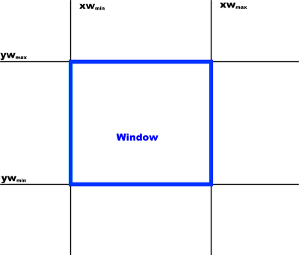
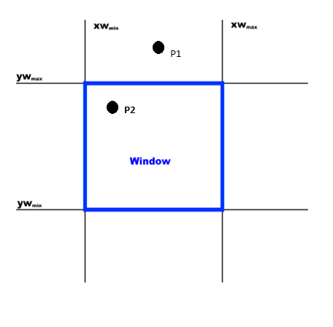
Point Clipping
Display P = (x, y) if xw_{min} <= x < = xw_{max} yw_{min} < = y <= yw_{max}

Slide 15
Point Clipping
Easy - a point (x, y) is not clipped if:
wx_{min} ≤ x ≤ wx_{max} AND wy_{min} ≤ y ≤ wy_{max}
otherwise it is clipped
P₄
Clipped
Clipped
Window
P₂
wy_{max}
Clipped
P₅
P₇
P₁
Points Within the Window are Not Clipped
P₉
P₈
wy_{min}
Clipped
P₁₀
wx_{min}
wx_{max}

Slide 16
Line Clipping
Harder - examine the end-points of each line to see if they are in the window or not
Situation | Solution | Example
Both end-points inside the window | Don’t clip
One end-point inside the window, one outside | Must clip
Both end-points outside the window | Don’t know!

Slide 17
Cohen Sutherland Algorithm

Slide 18
Cohen Sutherland Algorithm
P
1
0
0
0
1
0
0
1
1
0
1
0
0
0
0
1
0
0
0
0
0
0
1
0
0
1
0
1
0
1
1
0
0
1
0
0
A
B
R
L
P =
1
0
0
1
Trivial accept: Codes for both end points are 0000
Trivial reject: Codes for both end points have a 1 in the same position.

Slide 19
Cohen-Sutherland: World Division
World space is divided into regions based on the window boundaries
Each region has a unique four bit region code
Region codes indicate the position of the regions with respect to the window
1001 | 1000 | 1010
0001 | 0000 Window | 0010
0101 | 0100 | 0110
3
2
1
0
above
below
right
left
Region Code Legend

Slide 20
Cohen-Sutherland: Labelling
Every end-point is labelled with the appropriate region code
P₁₁ [1010]
P₄ [1000]
Window
wy_{max}
P₆ [0000]
P₃ [0001]
P₅ [0000]
P₁₂ [0010]
P₇ [0001]
P₉ [0000]
P₈ [0010]
wy_{min}
P₁₀ [0100]
P₁₃ [0101]
P₁₄ [0110]
wx_{min}
wx_{max}

Slide 21
Cohen-Sutherland: Lines In The Window
Lines completely contained within the window boundaries have region code [0000] for both end-points so are not clipped
P₁₁ [1010]
P₄ [1000]
Window
wy_{max}
P₆ [0000]
P₃ [0001]
P₅ [0000]
P₁₂ [0010]
P₇ [0001]
P₉ [0000]
P₈ [0010]
wy_{min}
P₁₀ [0100]
P₁₃ [0101]
P₁₄ [0110]
wx_{min}
wx_{max}

Slide 22
Cohen-Sutherland: Lines Outside The Window
Any lines with a common set bit in the region codes of both end-points can be clipped
The AND operation can efficiently check this
P₁₁ [1010]
P₄ [1000]
Window
wy_{max}
P₆ [0000]
P₃ [0001]
P₅ [0000]
P₁₂ [0010]
P₇ [0001]
P₉ [0000]
P₈ [0010]
wy_{min}
P₁₀ [0100]
P₁₃ [0101]
P₁₄ [0110]
wx_{min}
wx_{max}

Slide 23
Clipping
analytically calculating the portions of primitives within the viewport

Slide 24
Cohen-Sutherland Examples
Consider the line P₉ to P₁₀ below
Start at P₁₀
From the region codes of the two end-points we know the line doesn’t cross the left or right boundary
Calculate the intersection of the line with the bottom boundary to generate point P₁₀’
The line P₉ to P₁₀’ is completely inside the window so is retained
Window
wy_{max}
P₉ [0000]
P₉ [0000]
wy_{min}
P₁₀’ [0000]
P₁₀ [0100]
wx_{min}
wx_{max}

Slide 25
Cohen-Sutherland Examples (cont…)
Consider the line P₃ to P₄ below
Start at P₄
From the region codes of the two end-points we know the line crosses the left boundary so calculate the intersection point to generate P₄’
The line P₃ to P₄’ is completely outside the window so is clipped
P₄’ [1001]
P₄ [1000]
Window
wy_{max}
P₃ [0001]
P₃ [0001]
wy_{min}
wx_{min}
wx_{max}

Slide 26
Cohen-Sutherland Examples (cont…)
Consider the line P₇ to P₈ below
Start at P₇
From the two region codes of the two end-points we know the line crosses the left boundary so calculate the intersection point to generate P₇’
Window
wy_{max}
P₇’ [0000]
P₇ [0001]
P₈ [0010]
P₈’ [0000]
wy_{min}
wx_{min}
wx_{max}

Slide 27
Cohen-Sutherland Examples (cont…)
Consider the line P₇’ to P₈
Start at P₈
Calculate the intersection with the right boundary to generate P₈’
P₇’ to P₈’ is inside the window so is retained
Window
wy_{max}
P₇’ [0000]
P₇ [0001]
P₈ [0010]
P₈’ [0000]
wy_{min}
wx_{min}
wx_{max}

Slide 28
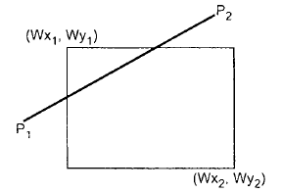
Algorithm
Read two end points of line say p1 (x1,y1) & p2 (x2, y2)
Read two corners of window say Wx1,Wy1, Wx2, Wy2
Assign Region codes for two end points p1 & p2. initialize code with bits 0000
Set bit 1 – if (x<Wx1)
Set bit 2 – if (x>Wx2)
Set bit 3 – if (y<Wy2)
Set bit 4 – if (y>Wy1)

Slide 29
Check for visibility of line p1 p2
If region code for both endpoints p1 and p2 are zero then line is completely visible. Hence draw line and go to step 9
If region code for endpoints are not zero and logical AND operation is also nonzero then the line is completely invisible, so reject the line and go to step 9
If region codes for two endpoints do not satisfy the conditions in 4a) and 4b) then line is partially visible.

Slide 30
Determine the intersecting edges of the clipping window by inspecting the region codes
a) If region codes for both endpoint are not zero, find intersection point p’₁ and p’2 with boundary edges of clipping window with respect to point p1 and p2 respectively
b} If region code for any one end point is non zero then find intersection point p1’ or p2’ with boundary edge of clipping window
Divide the line segment considering intersection points.
Reject the line segment if any one end point of it appears outside of clipping window
Draw the remaining line segments
Stop

Slide 31
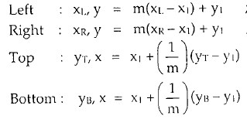
Cont..

Slide 32
Midpoint Subdivision Algorithm
Calculation for intersection point is avoided by repetitively subdividing the line at mid
Initially line is tested for visibility if visible then displayed otherwise rejected.
If line is partially visible then it is subdivided into equal parts and visibility test is applied on each half.
This process is repeated until we get completely visible and invisible line segments

Slide 33
Midpoint Subdivision Algorithm
Read two end points of line say p₁ (x₁,y₁) & p₂ (x₂,y₂).
Read two corners (left-top and right-bottom) of window say Wx₁, Wy₁ and Wx₂, Wy₂).
Assign Region codes for two end points p1 & p2. initialize code with bits 0000
Set bit 1 – if (x<Wx1)
Set bit 2 – if (x>Wx2)
Set bit 3 – if (y<Wy2)
Set bit 4 – if (y>Wy1)

Slide 34
Check for visibility of line
If region codes for both endpoints are zero then the line is completely visible. So draw line & goto step 6.
If region codes for endpoints are not zero and logical ANDing of them is also nonzero then line is completely invisible, so reject the line and go to step 6
If region codes for endpoints do not satisfy conditions above then line is partially visible
5. Divide the partially visible line segment in equal parts and repeat step 3 through 5 for both subdivided line segments until you get completely visible and completely invisible line segments

Slide 35
Cont....

Slide 36
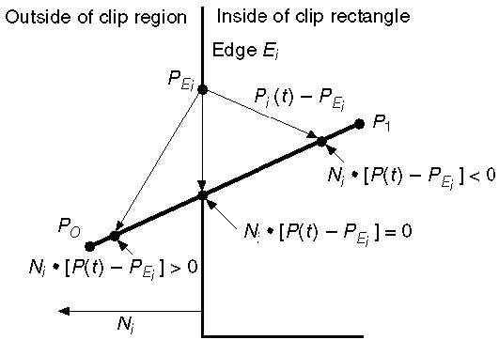
Cyrus-Beck Line Clipping Algorithm

Slide 37
Cyrus-Beck Line Clipping Algorithm

Slide 38
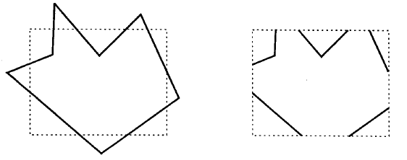
Polygon Clipping
Polygon is collection of lines.
We can’t apply line clipping algo on polygon, when we clip polygon, the original polygon becomes more open

Slide 39
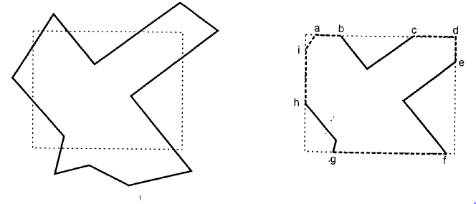
Polygon Clipping
Hence after clipping polygon remain closed.
To achieve this we have to generate additional line segments

Slide 40
Sutherland Hodgeman Polygon Clipping
Polygon clipped by processing its boundary as whole against each edge of clipping window.
Polygon is clipped by a window we need 4 clippers.
Left clipper , Right Clipper, Bottom Clipper, Top Clipper
At each step new set of vertices are generated & passed to next clipper

Slide 41
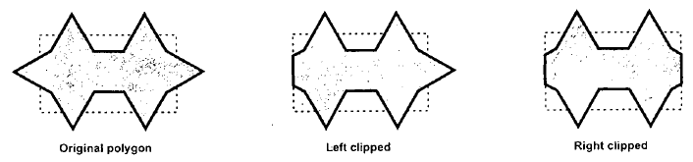
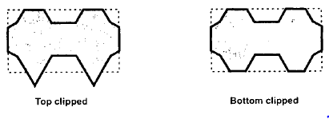

Slide 42
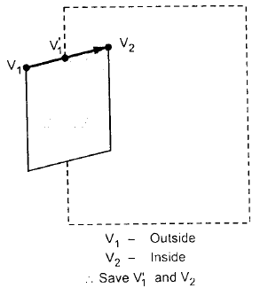
Sutherland Hodgeman Polygon Clipping
Each edge of polygon is individually compared with clipping plane.
1. If the first vertex of the clipping edge is outside the window & second vertex is inside then intersection point of polygon edge with window boundary and second vertex are added to output vertex list

Slide 43
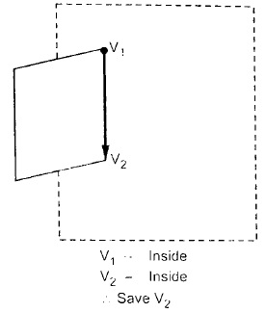
Sutherland Hodgeman Polygon Clipping
2. If both vertices of the edge are inside the window boundary, only second vertex is added to output list.

Slide 44
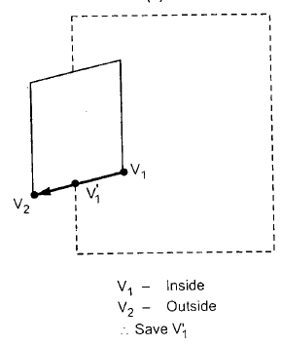
Sutherland Hodgeman Polygon Clipping
3. If the first vertex of the edge is inside and second vertex is outside, then only the intersection with the window boundary is added to output vertex list

Slide 45
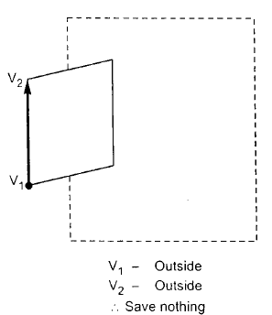
Sutherland Hodgeman Polygon Clipping
If both vertices are outside of the window boundary, nothing is added to the output list.

Slide 46
Sutherland Hodgeman Algorithm
Read coordinates of all vertices of the polygon
Read coordinates of the clipping window
Consider left edge of the window
Compare the vertices of each edge of polygon, individually with the clipping plane
Save the resulting intersections and vertices in the new list of vertices according to four possible relationships

Slide 47
Sutherland Hodgeman Algorithm
5. between edge and clipping window boundary
6. Repeat the steps 4 and 5 for remaining edges of the clipping window. Each time the resultant list of vertices is successively passed to process the next edge of clipping window
7. Stop

Slide 48
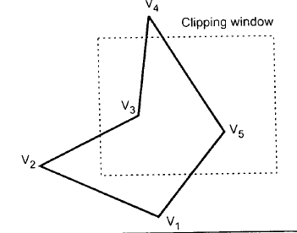
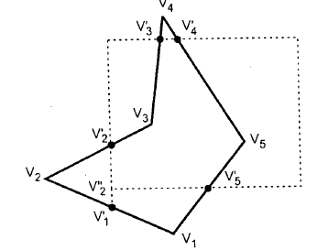
Example
After left Clipping : V₁, V₁’, V₂’, V₃, V₄, V₅
After right Clipping : V₁, V₁’, V₂’, V₃, V₄, V₅
After top Clipping : V₁, V₁’, V₂’, V₃, V₃’ V’₄, V₅
After bottom Clipping : V₂’’, V₂’, V₃, V’₃, V’₄, V₅, V’₅

Slide 49
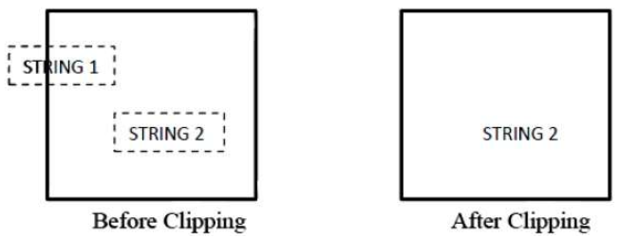
Text Clipping
All or none string clipping
Boundary position of rectangular area around text is compared with window.
String is rejected if these two boundaries overlapped

Slide 50
2. All or None Character Clipping
This clipping method is based on characters rather than entire string.
If the string is entirely inside the clipping window, then we keep it. If it is partially outside the window, then −
You reject only the portion of the string being outside
If the character is on the boundary of the clipping window, then we discard that entire character and keep the rest string.

Slide 51
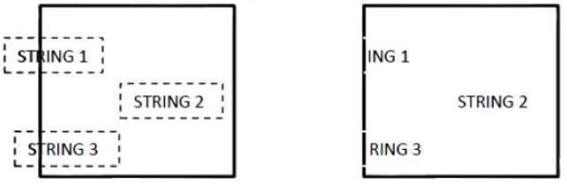
2. All or None Character Clipping

Slide 52
3. Text Clipping
This clipping method is based on characters rather than the entire string.
If the string is entirely inside the clipping window, then we keep it. If it is partially outside the window, then
You reject only the portion of string being outside.

Slide 53
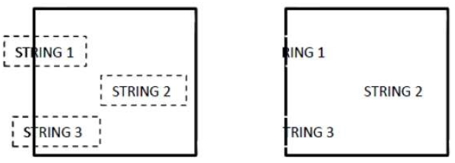
3. Text Clipping
If the character is on the boundary of the clipping window, then we discard only that portion of character that is outside of the clipping window.

Slide 54
Question Bank
Solve the following question (2 Marks)
Define window & viewport …………………………….(R)
What is clipping & windowing ……………………….(R)
List the different type of text clipping…………..(R)
List the line clipping algorithm……………………..(R)
Can line clipping algorithm be used for polygon clipping ? Justify? ……………………………………………………(A)

Slide 55
Question Bank
Solve the following question (4 Marks)
Explain the Cohen Sutherland line clipping algorithm…..(U)
Use the Cohen- Sutherland outcode algorithm to clip two lines P1(40,15)- P2( 75,45) & P3 (70,20)-P4( 100,10) against a window A( 50,10) ,B( 80,10), C(80,40), D( 50,40) ……….(A)
Describe Sutherland Hodgman polygon clipping algorithm…. (U)
Explain the mid-point subdivision method of line clipping………………………………(U)

Slide 56
Question Bank
5. What is need of normalized device coordinate ……..(A)
6 . Write a short note on Viewing transformation……..(U)
7. Write procedure for calculating an intersection point of line segment with rectangular boundaries ……………………(U)
8. Explain Cyrus Beck algorithm to determine whether a point on line , is inside ,on or outside a window……….(U)
9. Use outcode based on line clipping to clip a line starting from (-13,5) & end at (17,11)against window having its lower left corner at (-8,-4) & upper right corner at(12,8)………..(A)

